Slide 1
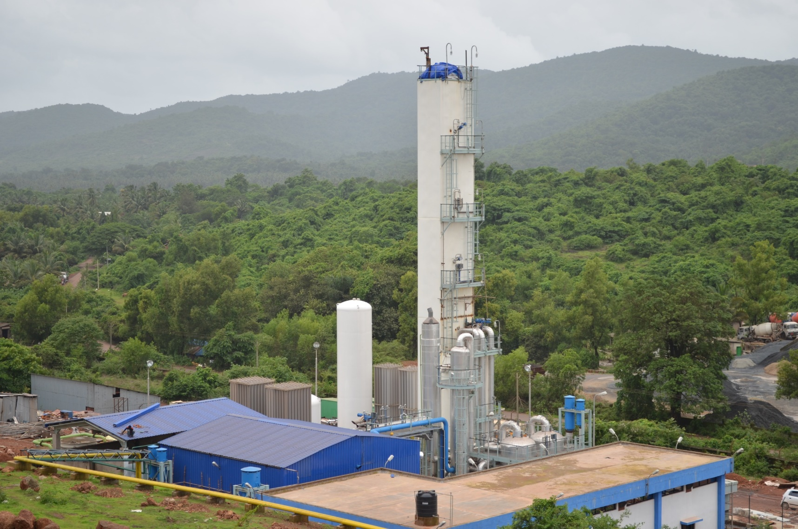
OXYGEN PLANT-
Tonnage Cryogenic Plant
What is Oxygen Plant /O2N2 Plant /ASU ?
Why it is needed. Oxygen or Nitrogen ?
Every 1 % of O2 Enrichment increase productivity by 2.5-4 %

Slide 2
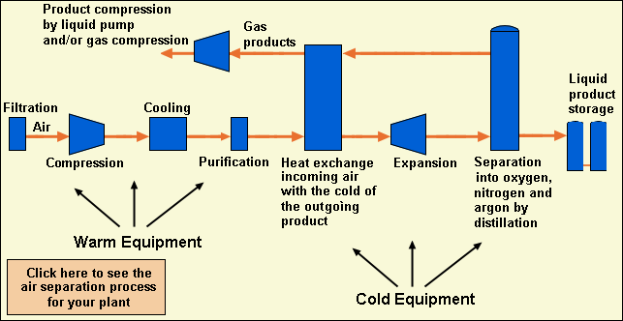
Air Separation Process Overview
Main Air Compressor
DCAC & EVC
Pre- Purification Unit

Slide 3
Air separation
N2
Gaseous N₂
HEATER
Gaseous O₂
O2
Low Pressure
Column
Liquid O₂
Liquid N₂
Molecular
Sieves
Turbine
Subcoolers
Main Heat
Exchanger
Waste N₂
EVC
CT
DCAC
High Pressure
Column
Air
MAC

Slide 4
Single line diagram
N2
Air separation process
PSA type - Pressure swing adsorption.
- Less than 25 TPD plant & less purity 93%.
VPSA type - Vacuum s\pressure swing adsorption..
- 25 to 75 TPD & less purity 93%.
Cryogenic type :
75 to 5500 TPD
high purity 99.95% & multi products.
Gaseous N₂
HEATER
Gaseous O₂
O2
Low Pressure
Column
Liquid O₂
Liquid N₂
Molecular
Sieves
Turbine
Subcoolers
Main Heat
Exchanger
Waste N₂
EVC
CT
DCAC
High Pressure
Column
Air
MAC

Slide 5
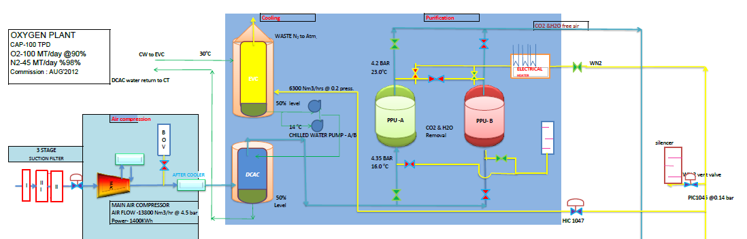
Compression & Purification
Air filtration-0.4 micron-92%
Air compression
4.5 bar g at 40 C
Air cooling
up to 16 C.
Air purification-Co2/H20- Nil.

Slide 6
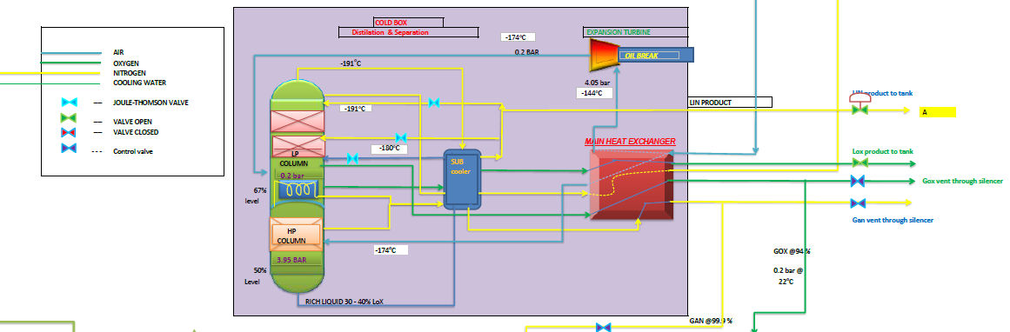
Cold Box –Equipment's
Cold box:
Main heat Exchanger
Distillation columns-LP/HP
Exp. Turbine.
Outer box with perlite powder.

Slide 7
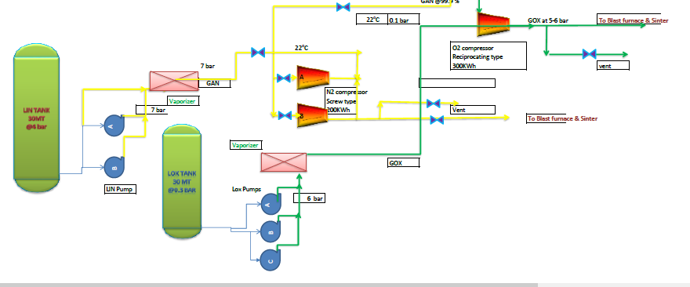
Product Supply-SVD
Compressor:
N2 compressor-02 nos , screw type.
O2 compressor
01 no- Reciprocating .
SVD:
Lox tank
30 T @ 0.2 bar
Lin tank
30 T @ 4 bar
Liquid product
Liquid purchase

Slide 8
Application of O2
5” flow control valve
O2 Application
HBS Cold blast - O2 Enrichment-
Cast - lancing
PCM -scull cutting
Sinter m/c-
O2 Enrichments
6” pipeline
Blast Furnace area
O2N2
6” ON/OFF
Ball Valve
LOX
Sinter Plant
2.5” pipeline
Application of N2
N2 Application
GCP- puffing, purging
Furnace- BLT cooling, ,lance flushing
PCM- De-dusting puffing.
PCI- grinding mill & tank pressuring
BFG line purging.
ONLINE Analyzer purging
6” flow control valve
6” pipeline
Blast Furnace area
O2N2
LIN
PIC-Auto valve
Sinter Plant
4” pipeline
8

Slide 9
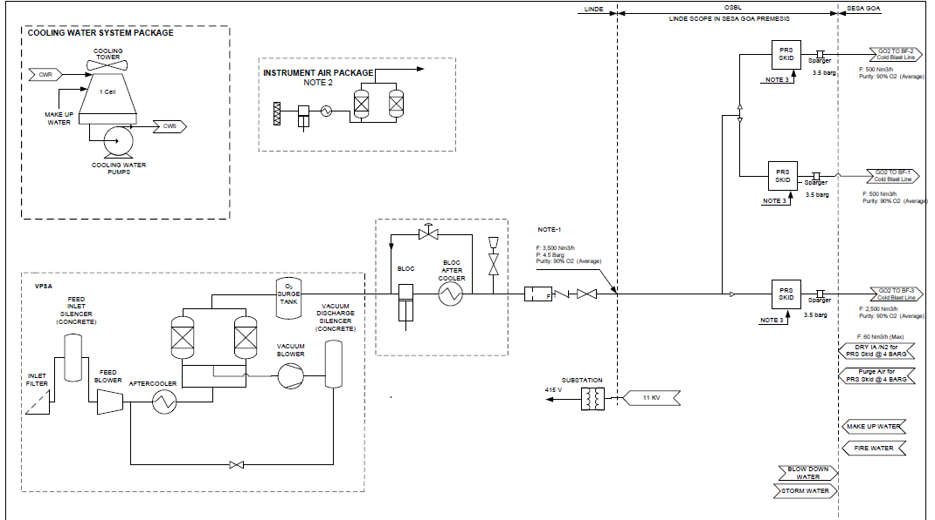
Oxygen Plant-2 (VPSA type)
Type :VPSA Oxygen Plant.
Oxygen flow -:3500Nm3/hr,93%,
BF3-: 2500Nm3/hr,
BF1/2-: 500 Nm3/hr

Slide 10
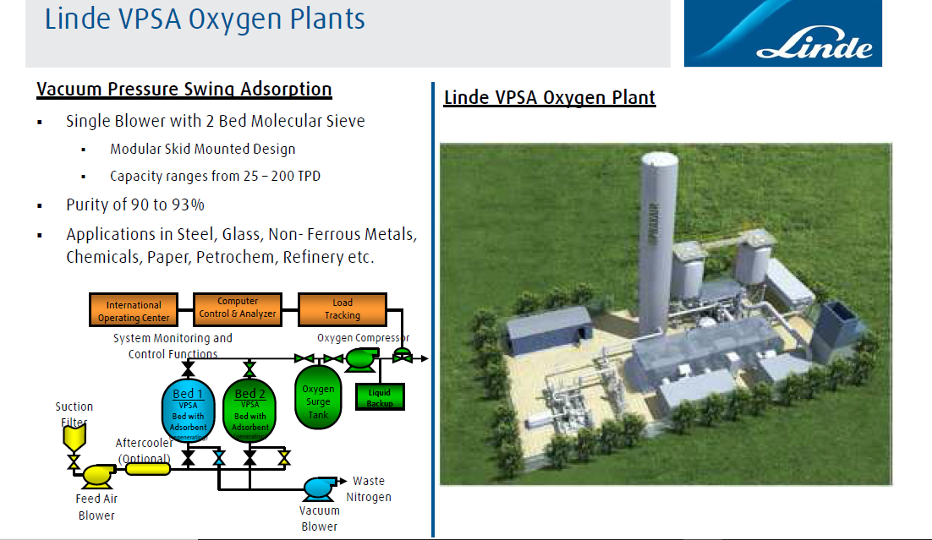
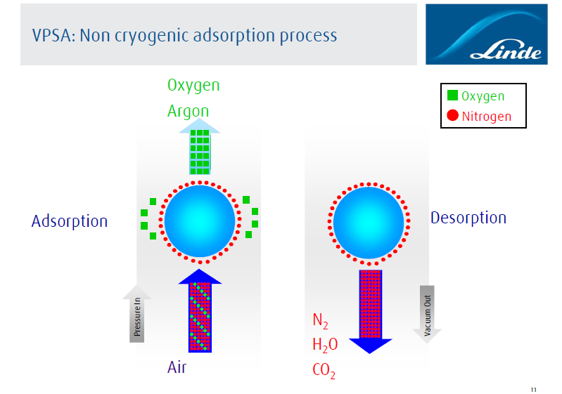

Slide 11
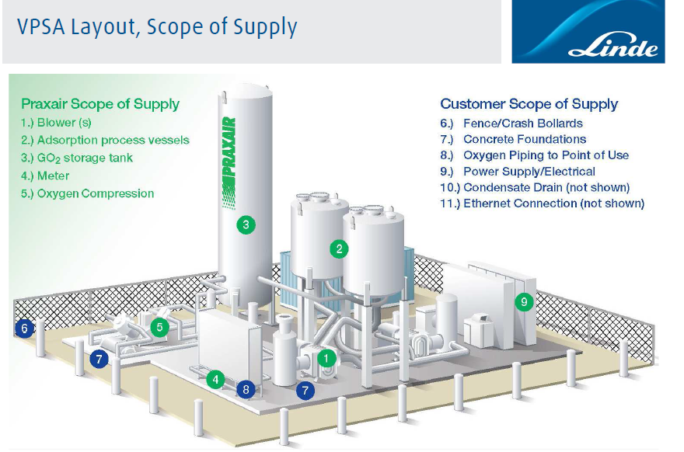

Slide 12
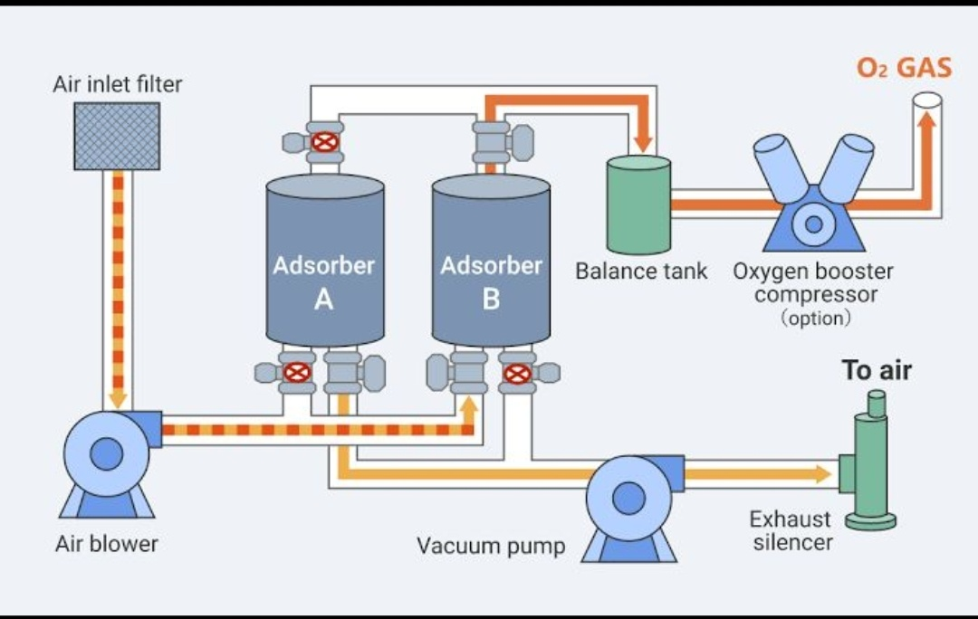
Oxygen Plant- (VPSA type)

Slide 13
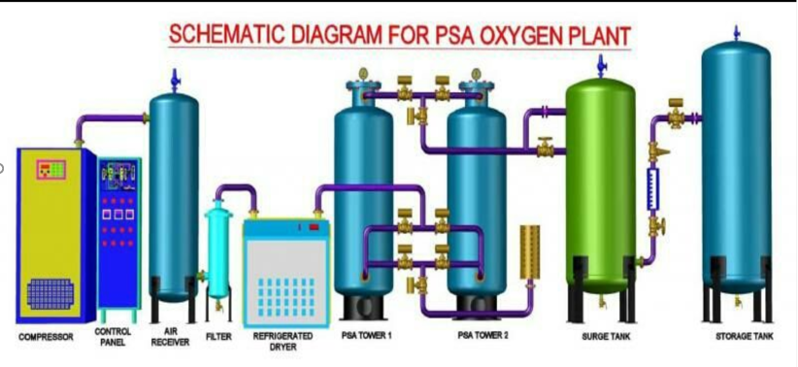
Nitrogen PSA Plant

Slide 14
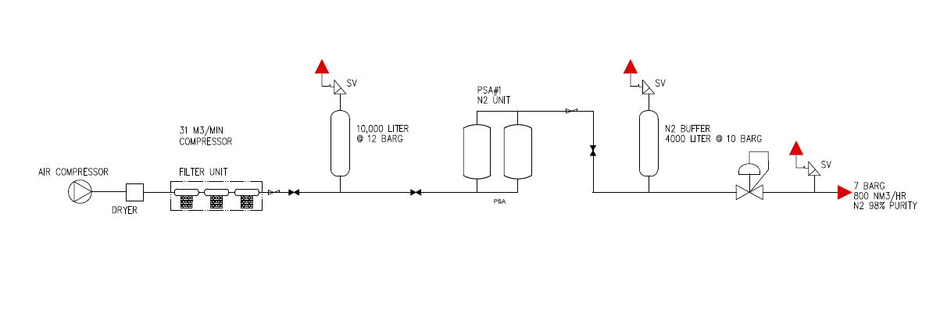
Nitrogen PSA Plant
Type of Plant: PSA Nitrogen Generator
Nitrogen flow: 800Nm3/hr ,
Purity : 98% ,
Pressure : 7 barg ,
Adsorbent: ZMS (Zeolite molecular sieve)

